Slide 1
Topic 6B Ubuntu Linux Quick Tour

Slide 2
Contents
Logging in
Running Commands (remotely)
Managing Terminals
Getting Help (man, info, HOWTO)

Slide 3
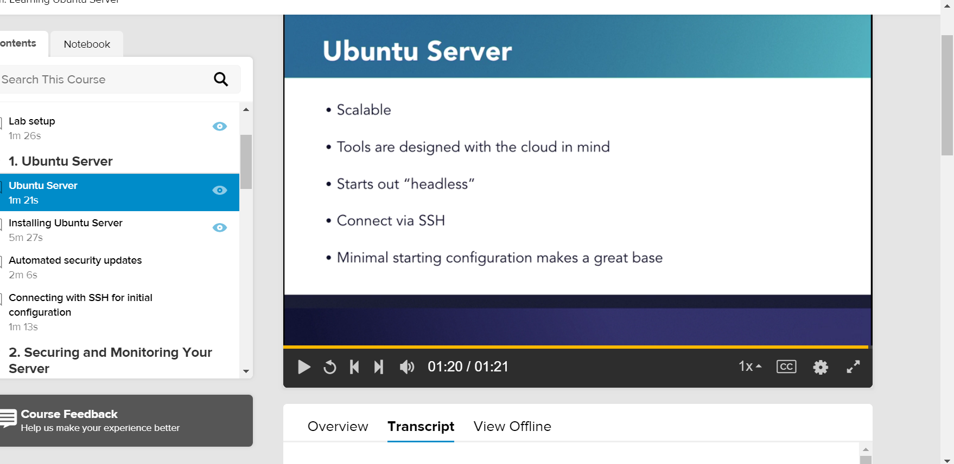
Notes:
Ubuntu Server is a version of Ubuntu Linux that's intended for use on servers of various types. Canonical, the company behind Ubuntu, envisions Ubuntu Server scaling from a single server to 10s of thousands, and the current version of Ubuntu Server 18.04 are designed with this philosophy. The networking configuration system called Netplan can configure, and deploy the network settings with a script as is common in large datacenter build outs. The installer called Ubiquity uses the cloud init toolchain to set up the configuration of the system which is then used to install.
So even if you install on an old machine at home you're still using cloud scale tools to configure your server. Ubuntu Server installs without a GUI because, most of the time, servers don't have a display attached, and so we save the overhead of drawing a graphical environment that no-one is going to look at. Of course you can still install a desktop manager if you'd like, but out of the box, so to speak, Server doesn't come with one. So we need to interact with it through the console, or, more likely, through SSH. Ubuntu Server comes with OpenSSH Server configured, and ready to accept connections on a new install.
So we're able to connect as soon as the OS is installed. Ubuntu Server starts out in a pretty minimal state making it an efficient base for many uses. Because there's so many possibilities I'll introduce a few common topics, and I encourage you to further explore whatever you need your server to do. Be sure to search for courses in our library to support your learning.
Resume Transcript Auto-Scroll

Slide 4
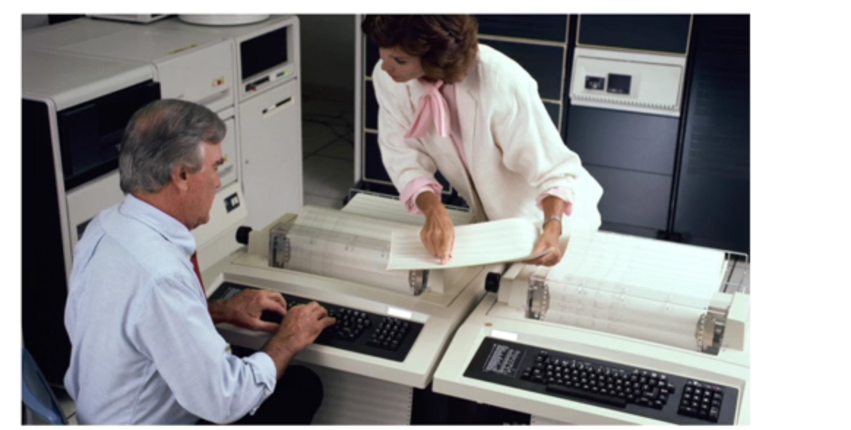
TTY Tele-TYpeWriter or Tele Type

Slide 5
Logging in
The root user is the administrator of the system. The root password should be kept securely
How to change root password in Ubuntu
The procedure to change the root user password on Ubuntu Linux:
Type the following command to become root user and issue passwd: sudo -i passwd
OR set a password for root user in a single go: sudo passwd root
Test it your root password by typing the following command: su -
Notes:
A note about root password on an Ubuntu server/desktop
Enabling the root account by setting the password is not needed. Almost everything you need to do as SuperUser (root) of an Ubuntu server can be done using sudo command. For example, restart apache server:
$ sudo systemctl restart apache2
You can add additional user to sudo by typing the following command:
$ sudo adduser {userNameHere} sudo
For example, add a user named tom to sudo:
$ sudo adduser tom sudo

Slide 6
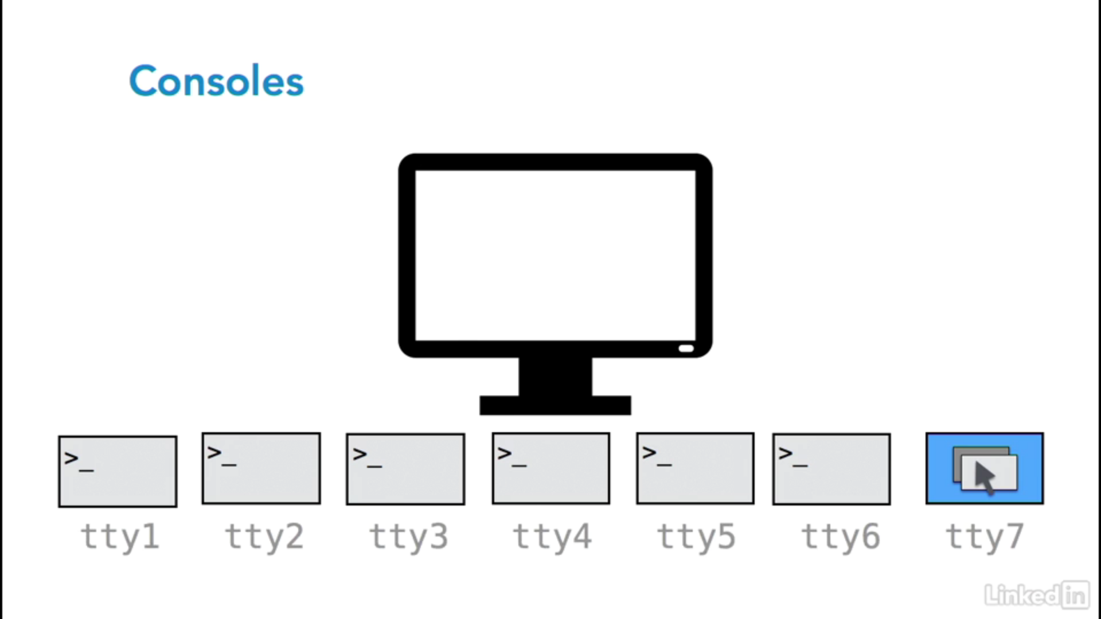
Logging in
Open a Linux Terminal Using Ctrl+Alt +T
The easiest way to open a terminal is to use the key combination of Ctrl+Alt+T.
Simply hold all three keys at the same time, and a terminal window will open.
An active terminal will quit if you tell it there's no more input.
That can be done with a quick Control+D.

Slide 7
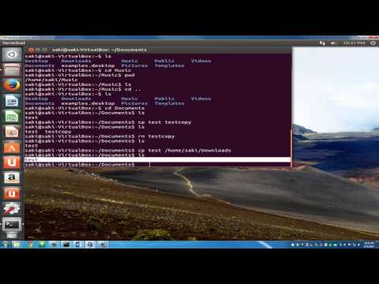
Demo

Slide 8
Commands
The who command shows who is logged in
The whoami print effective userid
The ifconfig command shows the IP address(es) of the systems
The su command to switch user
su - (with a hyphen) specify that the user should effectively log in as the new user.
The ssh (secure shell) allows users to log in to remote machines
The other machine must be configured to allow such remote logins
-X to enable X11 forwarding

Slide 9
Basic command in shell
cat - show file content
touch – create an empty file (if absent)
ls – list directory content
cd – change directory content
cp – copy file / folder
mv – move file / folder

Slide 10
Basic command in shell
mv – move file / folder
Renaming files with “mv” Command. A simple way torename files and folders is with the mv command (shortened from “move”). Its primary purpose is moving files and folders, but it can also rename them, since the act of renaming a file is interpreted by the filesystem as moving it from one name to another.
https://www.maketecheasier.com/rename-files-in-linux/
Notes:
Renaming files with “mv” Command
A simple way to rename files and folders is with the mv command (shortened from “move”). Its primary purpose is moving files and folders, but it can also rename them, since the act of renaming a file is interpreted by the filesystem as moving it from one name to another.
The following syntax is used to rename files with mv:
mv (option) filename1.ext filename2.ext
“filename1.ext” is the original, “old” name of the file, and “filename2.ext” is the new name.
The same pattern works for folder renaming. If the files are not located in the currently active folder, their full path has to be specified:
mv /home/user/Files/filename1.ext /home/user/Files/filename2.ext
Note that the mv command requires write permission for the folder containing the files. In the case of system files and folders, the user needs to obtain root permissions to rename files by prepending mv with sudo or su. An extra layer of protection is provided by the -i (interactive) option which asks the user to confirm the file rename before it’s actually applied.
There’s also the -v (verbose) option which lists all changes that have been made by mv. Options are written after mv but before the filenames.

Slide 11
Shell
A shell is an interactive process that allows the user to run a text command.
There are many different shells for Linux.
The default shell in Ubuntu Linux is the bash shell.
$ echo $SHELL
/bin/bash
When you type characters in the window, the terminal draws these characters in the window in addition to sending it to the shell's (or other program's) stdin. The characters the shell outputs to stdout and stderr get sent to the terminal, which in turn draws these characters in the window.
This is defined in the $SHELL environmental variable. You can check by typing echo $SHELL in the terminal.

Slide 12
Managing Terminals
Terminal Control Sequences
Control-C Abnormal interrupt – terminate the current process
Control-D To signal end of input
Control-H Backspace
Control-S Freeze the terminal display (thaw with Control-Q)
Control-Q Thaw the terminal display
Control-U Erase current line
Control-Z Suspend the current process
The tab key can be used, when typing, to help complete commands and files
Notes:
Control-Z suspends the current process and display the suspend job id.
To resume the suspended job type “fg <job id of suspended process>.
Type “jobs” to displayed list of suspended processes.

Slide 13
Man pages (Getting Help)
Manual pages (or “man pages”) provides reference information for Linux systems.
Option for man pages
man -k <keyword>
Displays pages of name and title containing <keyword>
May need makewhatis to regenerate the man database
man -K <keyword>
Search <keyword> within the man pages
man <section> <keyword>
Shows specific section of man pages

Slide 14
Man pages
Man pages are organised in 8 standard chapters.
Chapter Audience Topic
1 standard users Commands
2 developers System Calls
3 developers Library Calls
4 administrators Device Files
5 standard users File Formats
6 standard users Games
7 standard users General Information
8 administrators Admin Commands

Slide 15
Man pages
Navigation in man pages:
space View next page
b View previous page
q Quit
/<text> Search for the word <text>
n Find next occurrence of the search term

Slide 16
info pages
Contains hyperlink-like structure
May not covered as widely (usually newer commands)
Navigation in info
<SPACE> or <enter> move down (into link)
<del> or <backspace> move up (out of link)
b move to top
<tab> next node
p / n previous / next node

Slide 17
Howto documents
Article on “how to” complete certain task, in plain text write out.
Found on the web at http://tldp.org/docs.html
Found in selected command.
/usr/share/doc/<program>/HOWTO

Slide 18
Summary
Switching user (su)
Logging to graphical and virtual consoles (ssh & ssh –X)
Working with terminal display
Getting help through man, info, HOWTO pages

